Slide 1
Headless Adobe Experience Manager – Beyond the Browser
Bryan Stopp | Technical Architect – Delivery Excellence

Slide 2
1 | Welcome and Overview
2 | Experience Fragments
3 | Content Fragment Models & Instances
4 | Component Exporter (Advanced)
Notes:
Welcome
Who I am
Who are my TA’s
Next Slide

Slide 3
Adobe User Experience Design Engagement
Some members Adobe’s User Experience Design group will be joining us today.
They are here to learn by observing your experiences.
While you should bring specific questions to your designated TAs, the Adobe Design TAs will be happy to hear any critiques, pain points, or suggestions on user experience you may like to share.
They can be identified by the gray Community Engagement t-shirts.
Notes:
Adobe UX/XD is here – feedback on how you use the product, interface, pain points, etc.

Slide 4
1 | Welcome and Overview
2 | Experience Fragments
3 | Content Fragment Models & Instances
4 | Component Exporter (Advanced)
Notes:
What are we going to talk about
XF
About 20-30 min in I’ll stop to talk about XF Building Blocks and explain some additional use cases
Let you go for another 10 min
Move on to CF
If we get to it, Content Exporter demo/follow along.

Slide 5
What is an
Experience Fragment (XF)
What is a
Content Fragment (CF)
When to use
XF vs CF

Slide 6
1 | Welcome and Overview
2 | Experience Fragments
3 | Content Fragment Models & Instances
4 | Component Exporter (Advanced)
Notes:
So let’s talk about XF

Slide 7
Experience Fragments (XF) – What is it?
A set of content that grouped forms an experience that should make sense on its own
Managed as a Page
Outputs HTML
Content & Channel use considerations
Rendered by AEM
Variations
Live Copy or Independent
Channel or Context Specific
Supports Translations

Slide 8
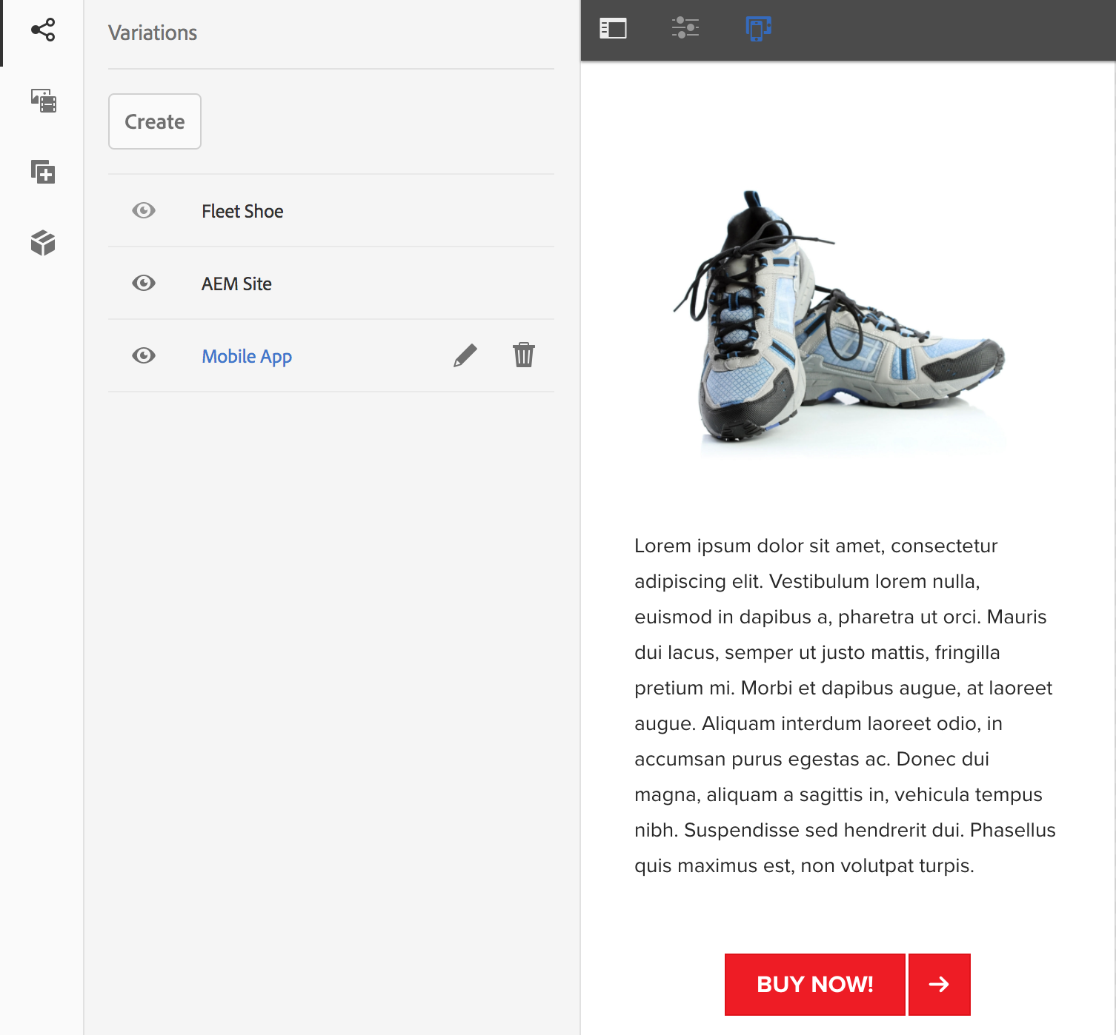
Experience Fragments (XF) - Activities
Create Experience Fragment
Create a Building Block
Create Variations
AEM Sites
Mobile App
Consume an XF
Update XF
Create from Existing Content (Adhoc)

Slide 9
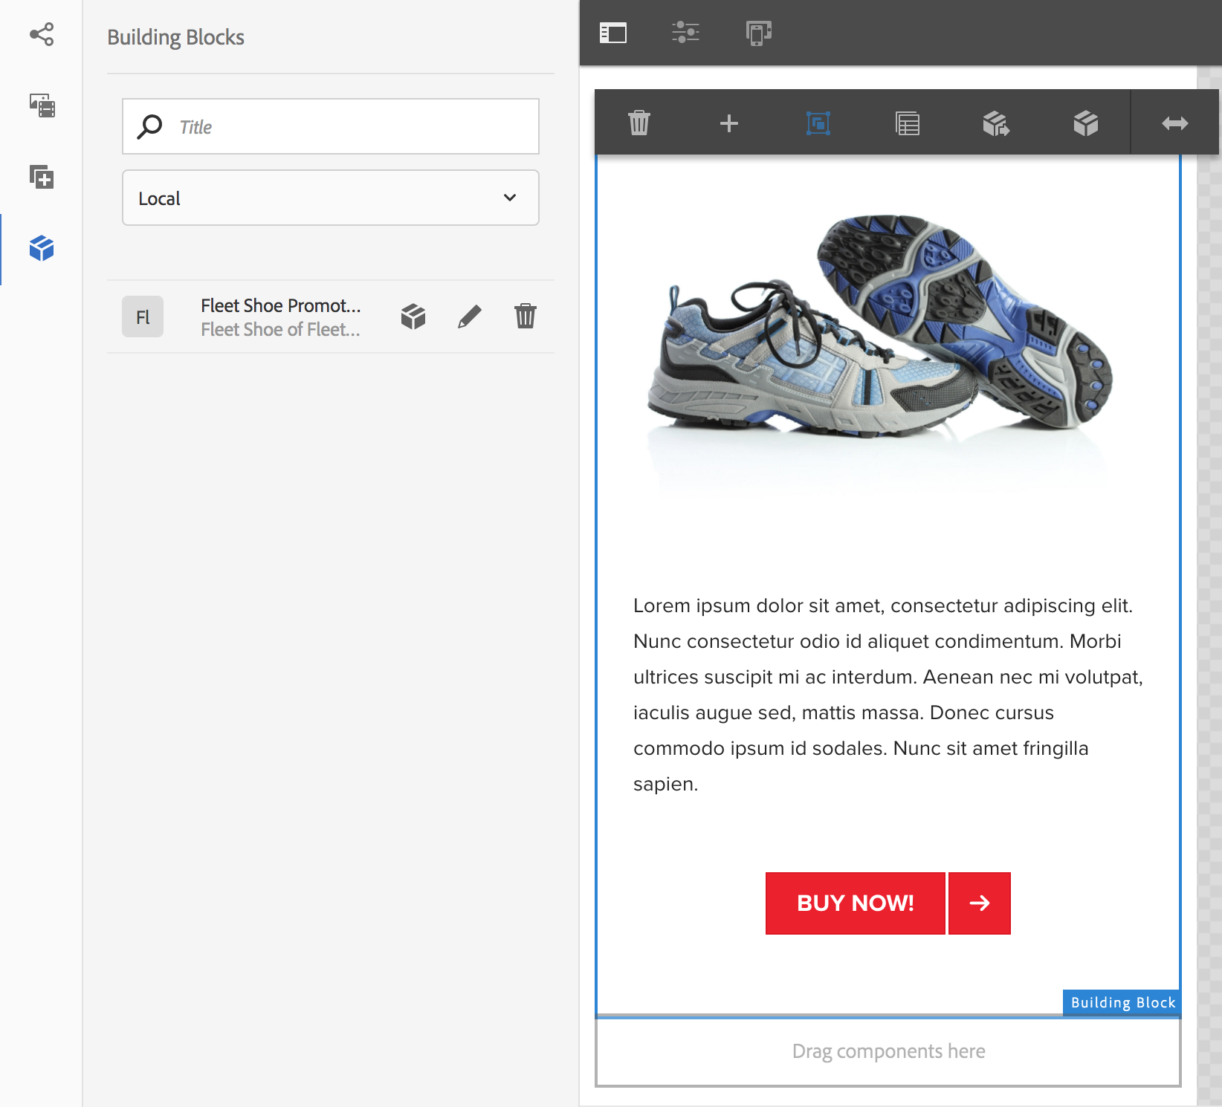
Experience Fragments - Building Blocks
Specifies reusable structure and content
Automatic updates of referencing XF
Usable across XF (Local vs All)
Best Practices:
One XF Variation holds building block
All other XF consume building block
Inheritance can be canceled
Removes back-reference for updates
Cannot be undone
Notes:
Hit these points

Slide 10
Experience Fragments (XF) - Activities
Create Experience Fragment
Create a Building Block
Create Variations
AEM Sites
Mobile App
Consume an XF
Update XF
Create from Existing Content (Adhoc)

Slide 11
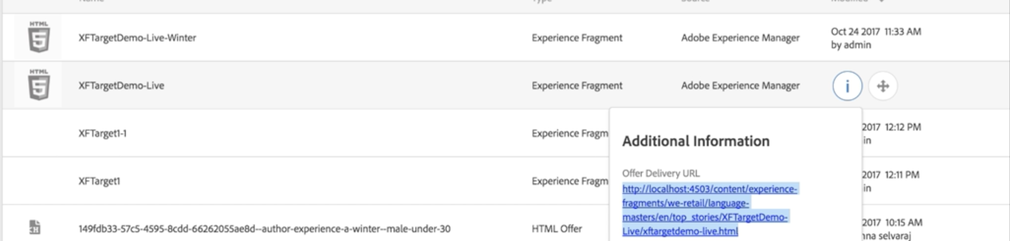
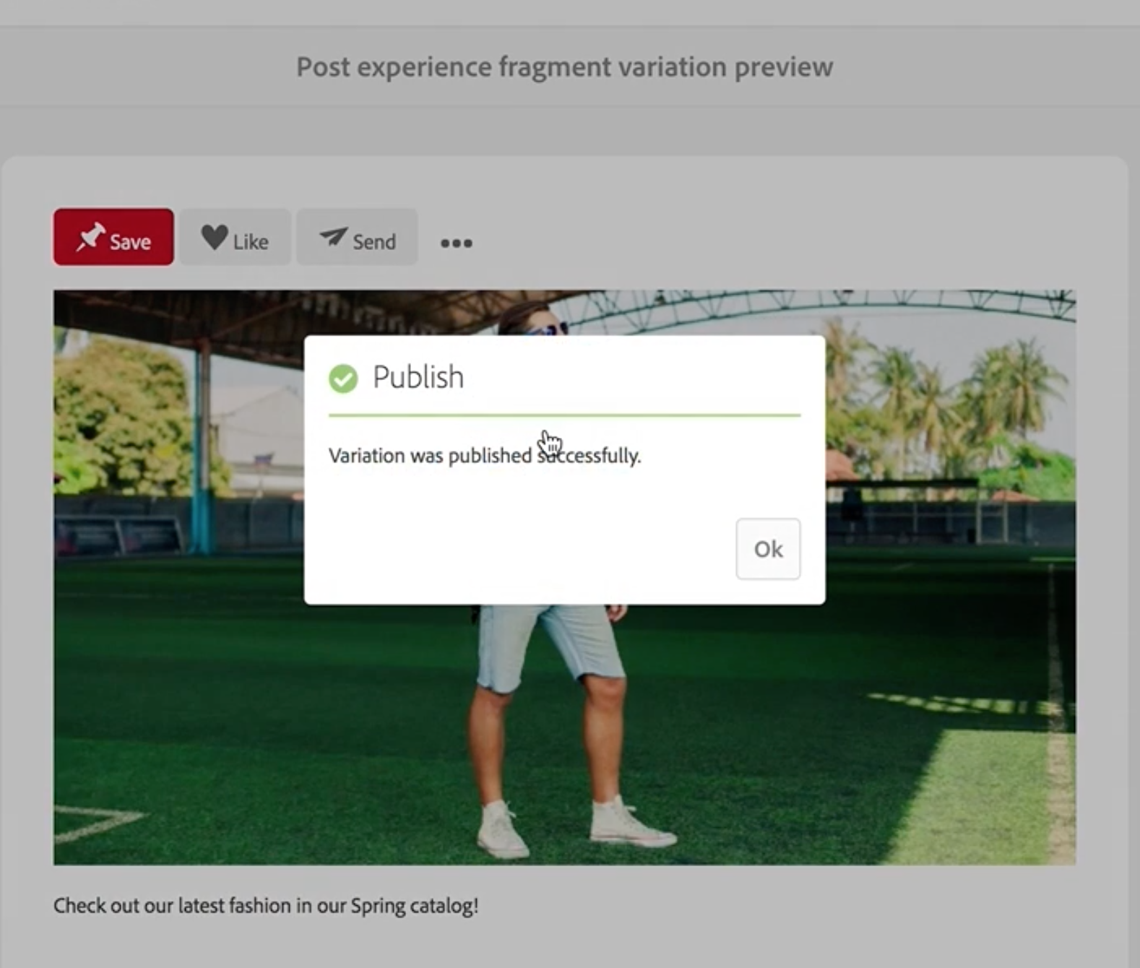
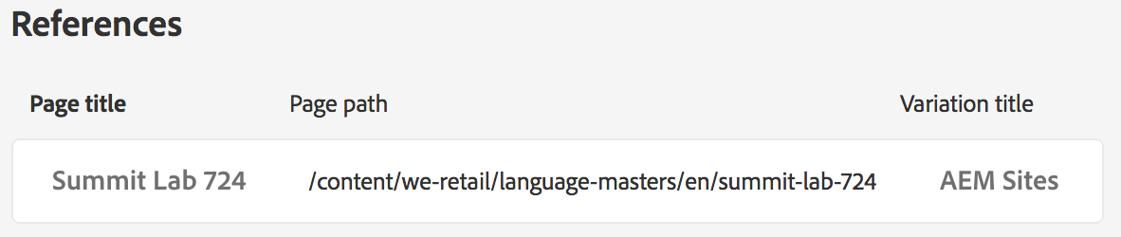
Experience Fragments - Extra Info
Beta – Publish To Target
Social Posting
Publishes XF to Social platform
Cloud Config. Req.
Content in XF is not “on page” when consumed directly
Displayed via reference
JCR based searches will return 0 results
Crawlers will still function as expected
Referenced pages available on XF Properties
Notes:
Name your XFs appropriately – When you export them to target they need to be descriptive so you can find/use them
Demo the Search/Lack – Be cognizant of this

Slide 12
Experience Fragments (XF) – Details
Managed as a Page
Editable Templates & Policies
Outputs HTML
XF Component renders container’s content only
Target integration similar – directly references content
Third-Party Considerations
Using Target on non-AEM sites (or other AEM Sites)
Will not be rendered as on AEM so,
Ensure any CSS and visual JS is on the updated site
Notes:
Show XF Template
Show HTML output on page

Slide 13
1 | Welcome and Overview
2 | Experience Fragments
3 | Content Fragment Models & Instances
4 | Component Exporter (Advanced)

Slide 14
Content Fragments (CF) –What is it?
Content without consideration of design
Text-based; long form
Managed as an Asset
Outputs structure
Channel provides layout & design
Rendered by Channel
Variations
Master is source of truth
Based on use-case
Supports Translations

Slide 15
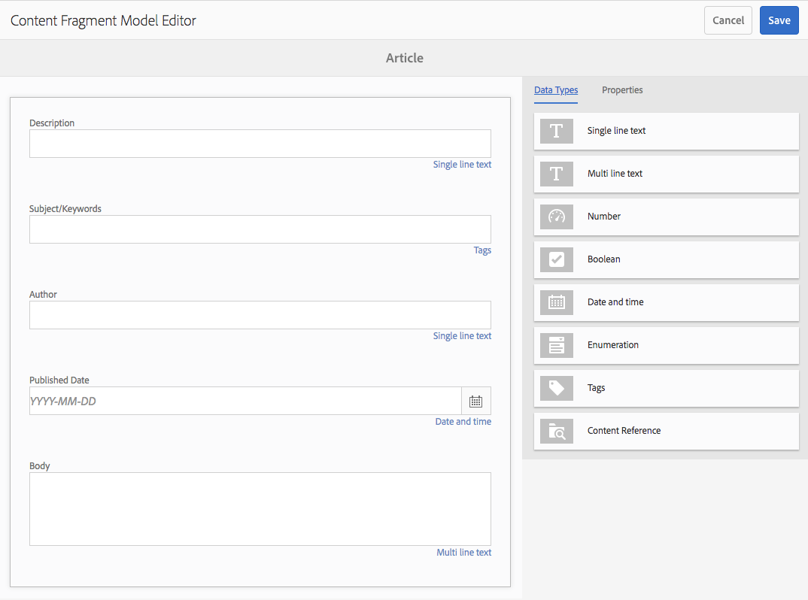
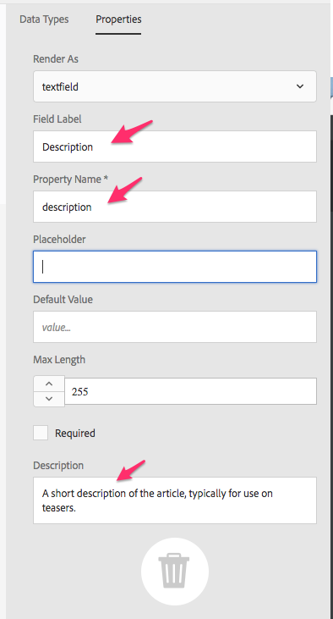
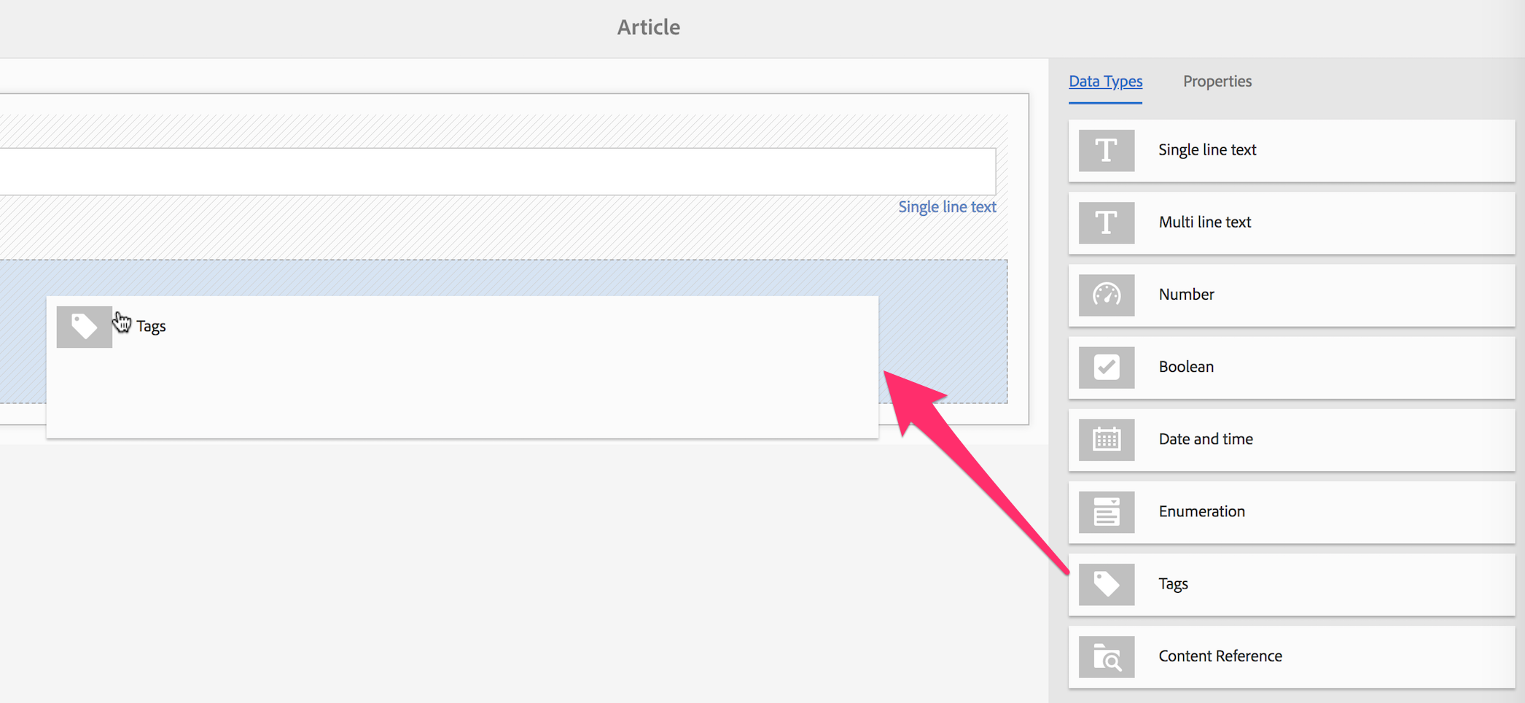
Content Fragment – Model Activities
Enabling Content Fragments
Assets Folder Configuration
Define Model Structure

Slide 16
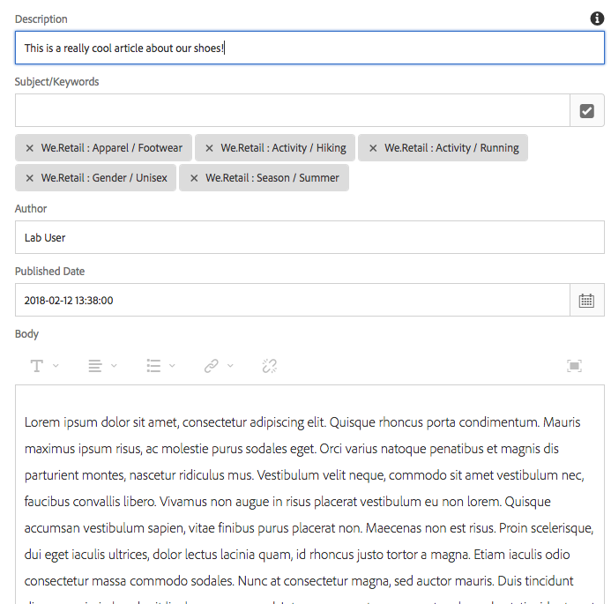
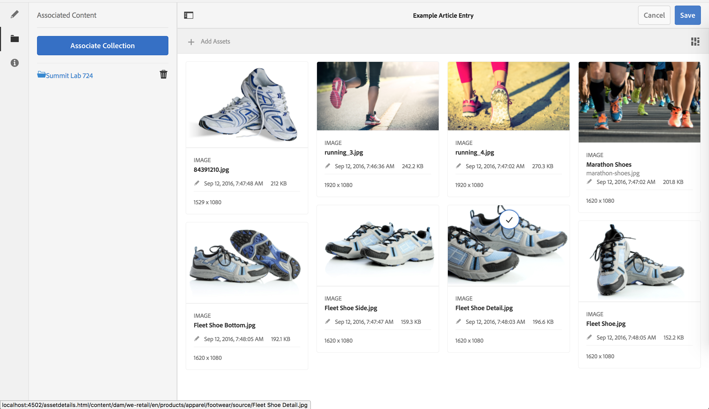
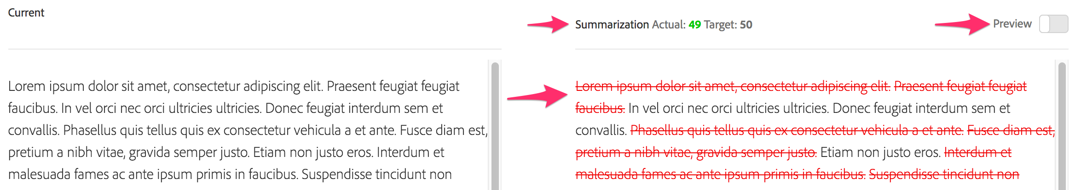
Content Fragment – Instance Activities
Create Content Fragment
Summarize
Associated Content

Slide 17
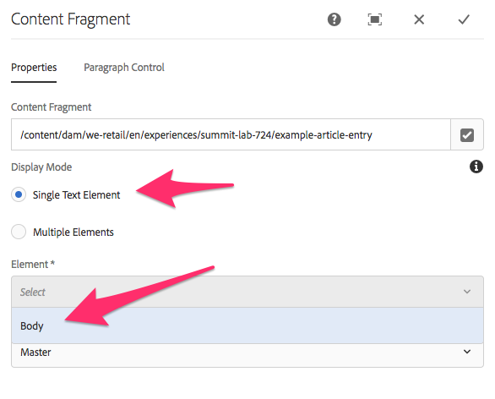
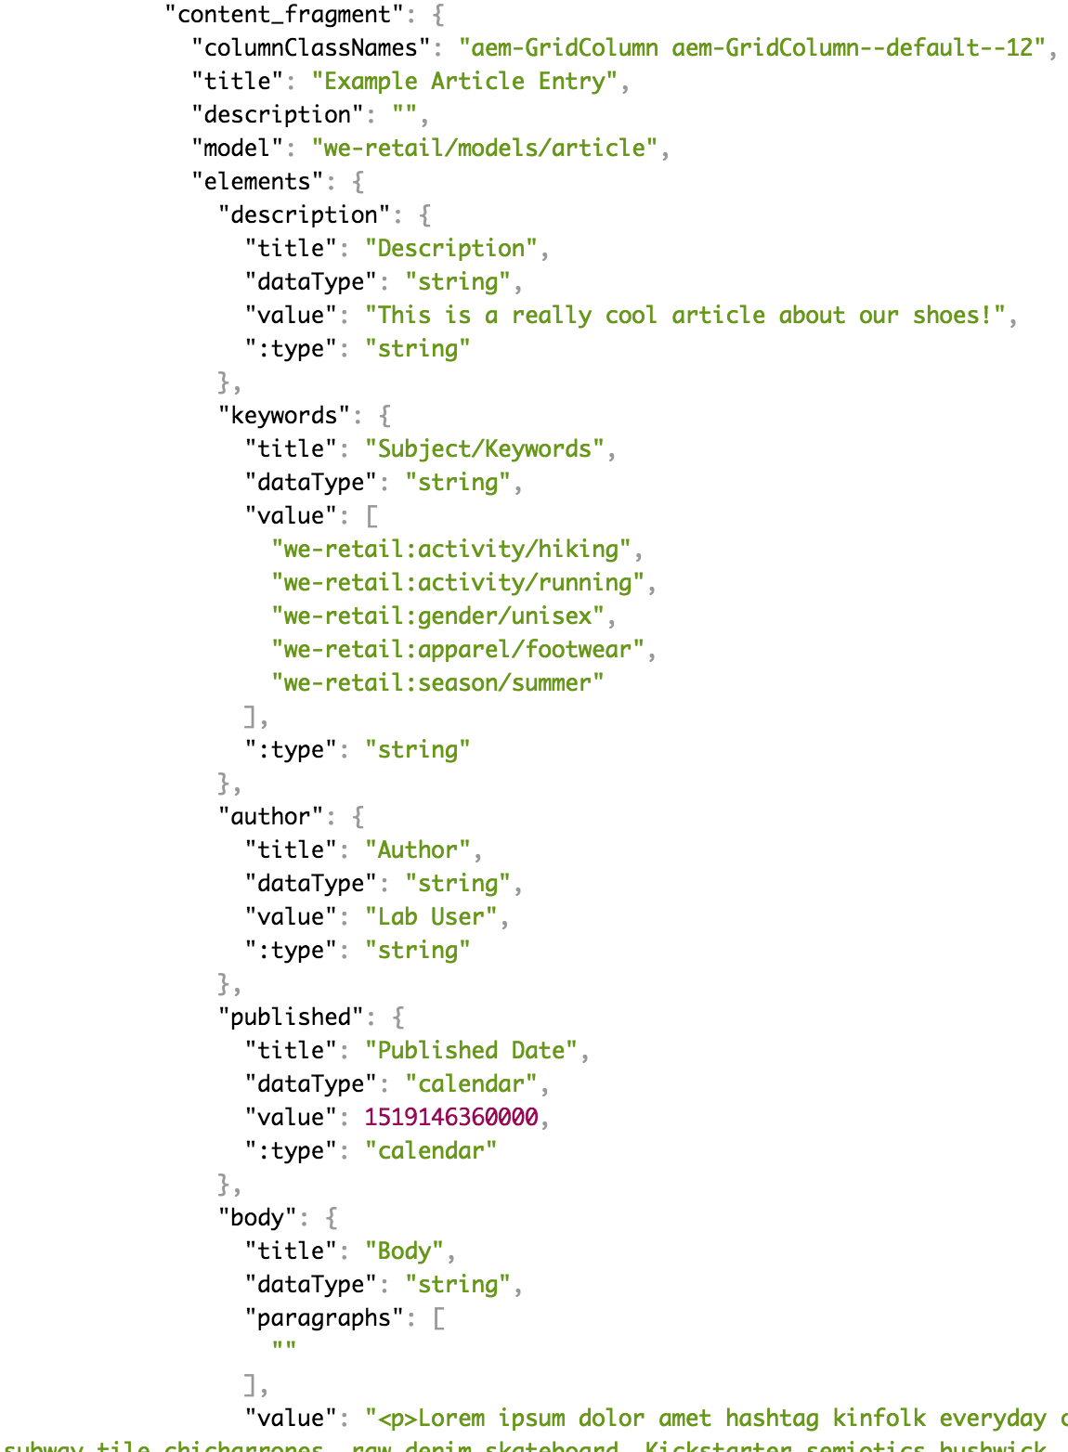
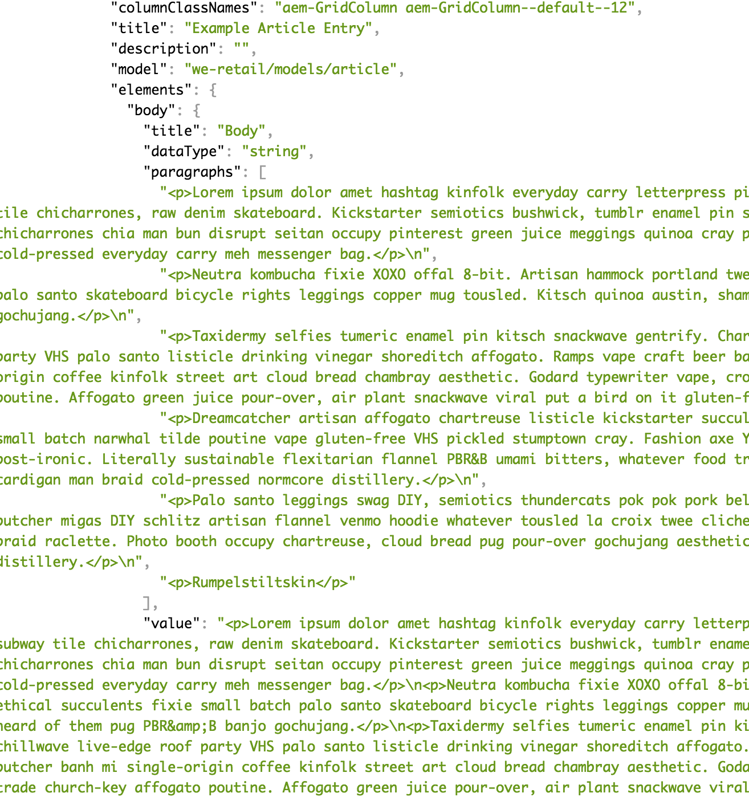
Content Fragment – Authoring Activities
HTML Page
Associated Content
Service API Page

Slide 18
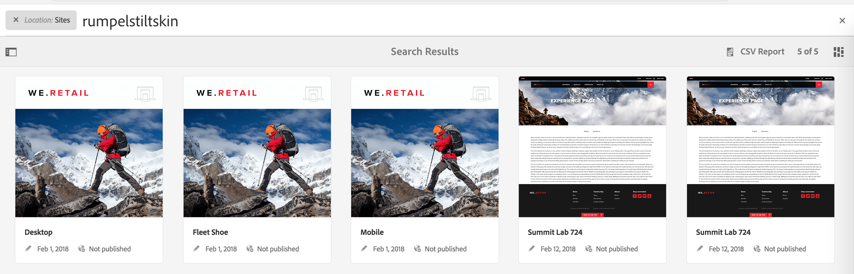
Content Fragments - Extra Info
No search limitations like XF
Content is copied to target Content Fragment component
Relationship managed via Multi-Site Manager library
Not visible in MSM dashboard. CORRECTION: Managed via custom Sling Events

Slide 19
Experience Fragments vs. Content Fragments
Experience Fragments
Group of components with layout that can live independently
Experiences for reuse.
Consumed as whole “thing”
Purpose
Cross Channel
3rd Party Consumption (Target)
Getting Technical
Page - cq:Page node structure
Content Fragments
Editorial / Semantic Copy
Logical grouping of data
Consumption based on use case
As much or as little as desired
Purpose
Site rendering
API/JSON
Getting Technical
Assets - dam:Asset node structure
https://helpx.adobe.com/experience-manager/kt/platform-repository/using/content-fragments-experience-fragments-article-understand.html

Slide 20
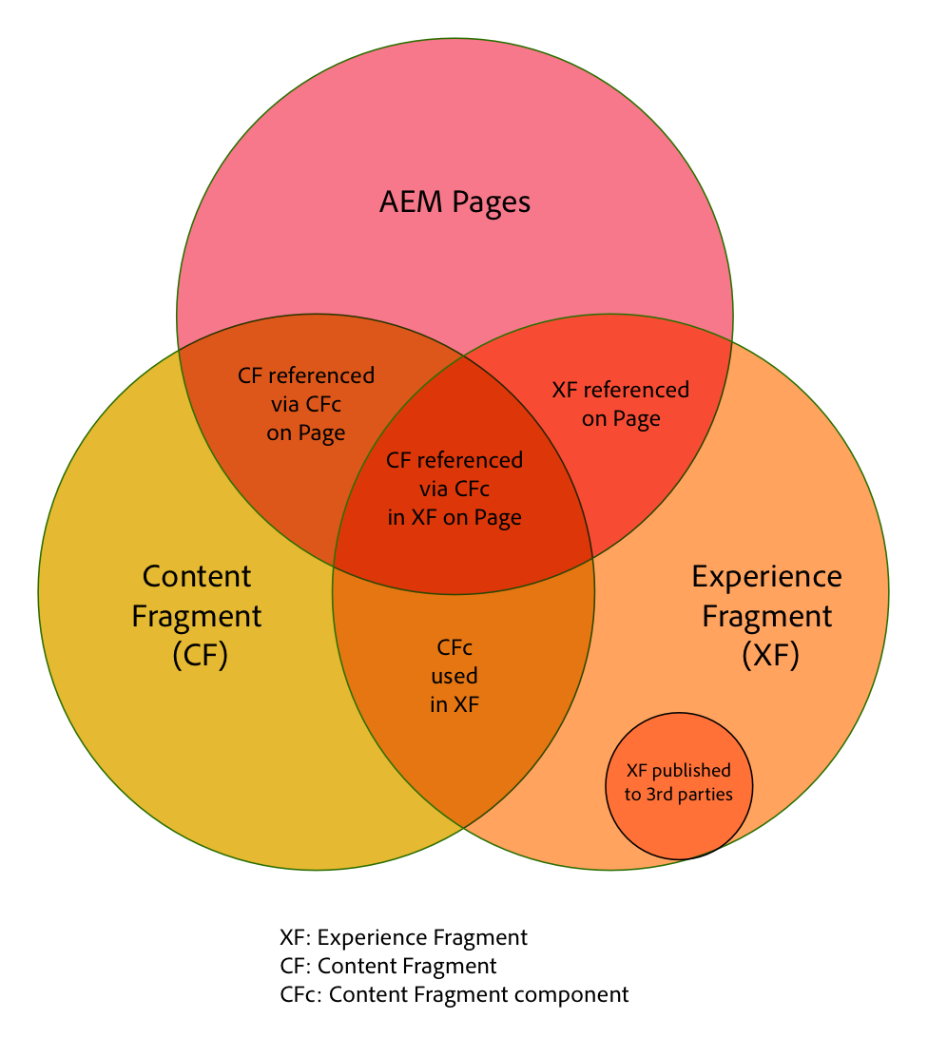
Experience Fragments & Content Fragments
https://helpx.adobe.com/experience-manager/kt/platform-repository/using/content-fragments-experience-fragments-article-understand.html

Slide 21
1 | Welcome and Overview
2 | Experience Fragments
3 | Content Fragment Models & Instances
4 | Component Exporter (Advanced)

Slide 22
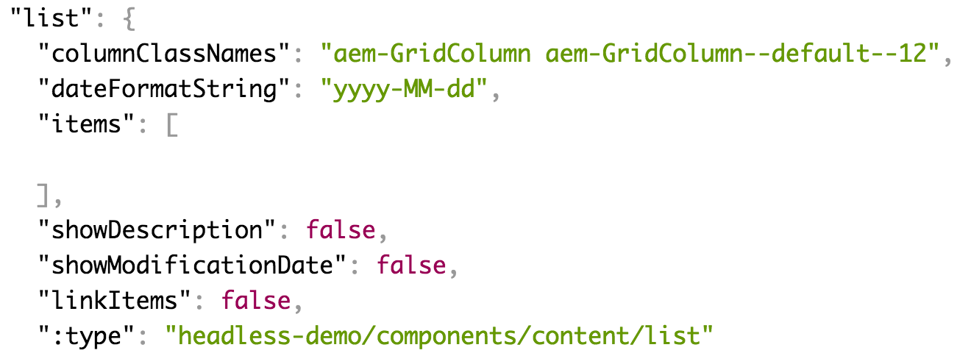
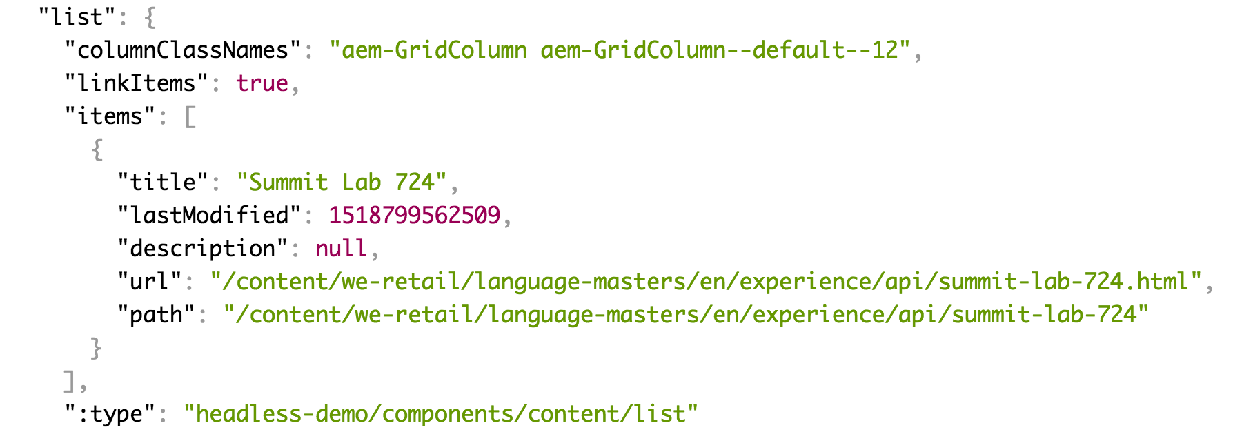
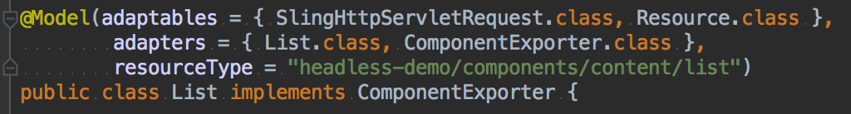
Component Exporter - Advanced Topics
Existing JSON Output
Component Model Update
Updated JSON
Notes:
This example uses a Sling Model, so your component may need to be updated/refactored. Can use w/ WCMUsePojo / JSUse but then duplicated business logic.

Slide 23
Bryan Stopp
stopp@adobe.com
Twitter: @StoppThinking

Slide 24
Summit 2018 GitHub Repo
https://github.com/Adobe-Marketing-Cloud/Summit2018
Branch L724

Slide 25




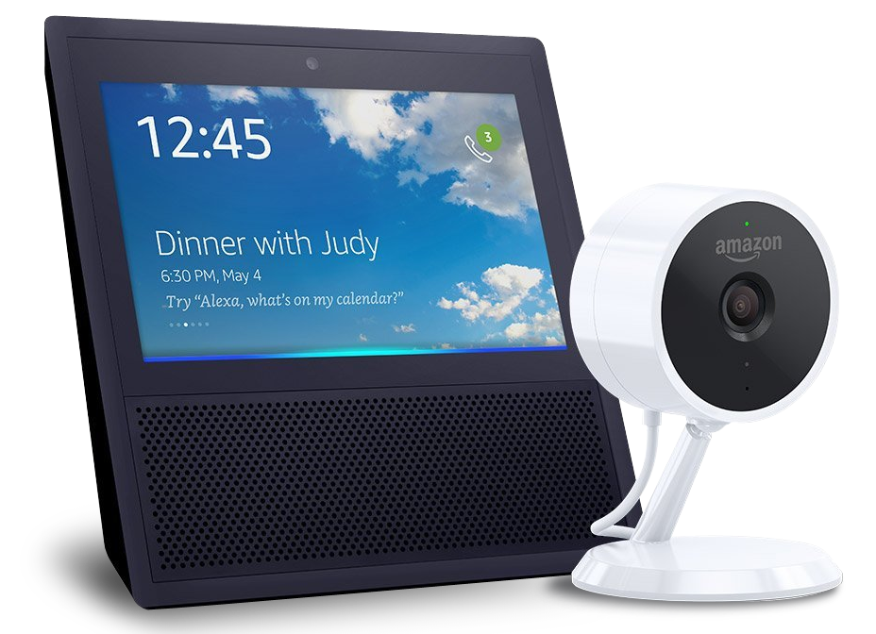
Take the Survey to win!
(Survey section of the mobile app)
SESSION PRIZE
one per session
$10
Starbucks
Card
DAY 1
DAY 2
DAY 3
Bash Experience
Signed football helmet
Amazon Echo Show & Cloud Cam Bundle

Slide 26


JOIN US IN THE COMMUNITY PAVILION
Get your SUMMIT SELFie!. Share with friends, earn badges, and win prizes.
Talk with our
Experience Experts from Services & Learning.
See live speaker sessions at the Experience Theater.
Notes:
EP to present

